Slide 1
Fraud Detection Project
Reporter: ㅤLiSaiㅤㅤㅤㅤㅤㅤㅤㅤㅤ

Slide 2

What are we solving?
We’re solving the problem of automatically identifying potentially fraudulent credit-card transactions in order to:
• Prevent financial loss by catching fraud before it settles
• Reduce manual review workload with high-precision, real-time scoring
• Improve customer experience by minimizing false declines of legitimate payments

Slide 3


Why does it matter？
• Financial impact: Fraudulent transactions cost banks and merchants billions annually.
• Customer trust: Undetected fraud erodes cardholder confidence; false positives frustrate genuine customers.
• Operational efficiency: Manual review teams are overwhelmed by alert volumes—automated detection frees up resources.
• Regulatory compliance: Rapid detection helps meet anti-money-laundering and fraud-reporting requirements.
• Business continuity: Minimizing fraud-related charge-backs and downtime protects revenue and brand reputation.

Slide 4



How did we achieve this?
We followed a three-stage approach:
1.Data Preparation & Feature Engineering
• Merged transaction and identity tables to assemble ~400+ features per record.
• Filled missing values (median for numerics; mode for categoricals).
• Created time features (hour of day, day of week) and card-level rolling statistics (24-hr average spend).
2. Unsupervised Anomaly Detection
• Reduced numeric feature space via PCA (20 components).
• Trained Local Outlier Factor, IsolationForest, and a lightweight autoencoder to assign anomaly scores.
• Evaluated each scorer’s ROC-AUC and PR-AUC to identify early warning signals.
3.Supervised Classification
• Standardized numeric features and ordinal-encoded categoricals.
• Trained baseline models (Logistic Regression, Random Forest) and gradient-boosted classifiers (XGBoost, CatBoost).
• Tuned for class imbalance using scale_pos_weight or built-in auto_class_weights.
• Selected the XGBoost pipeline (97%+ ROC-AUC, 0.78 PR-AUC) as our production model.
4.Deployment Pipeline
• Bundled imputer, scaler, encoder, and XGBoost model into a single fraud_inference_pipeline.pkl.
• Exposed a pipeline.predict_proba(raw_df) interface for real-time scoring.
This end-to-end solution delivers high-accuracy fraud flags with minimal manual intervention.

Slide 5
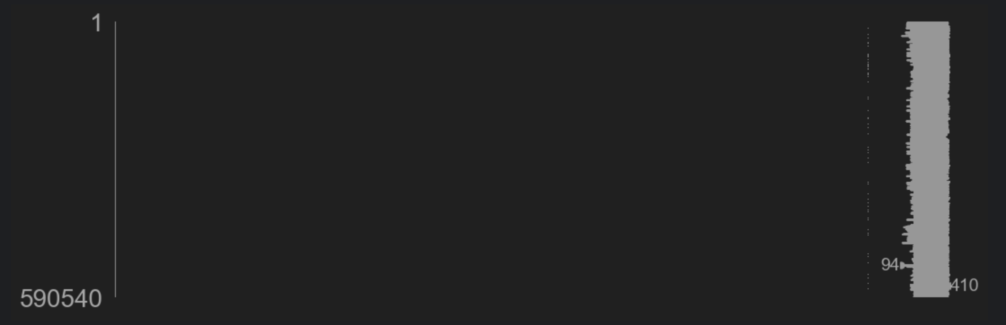
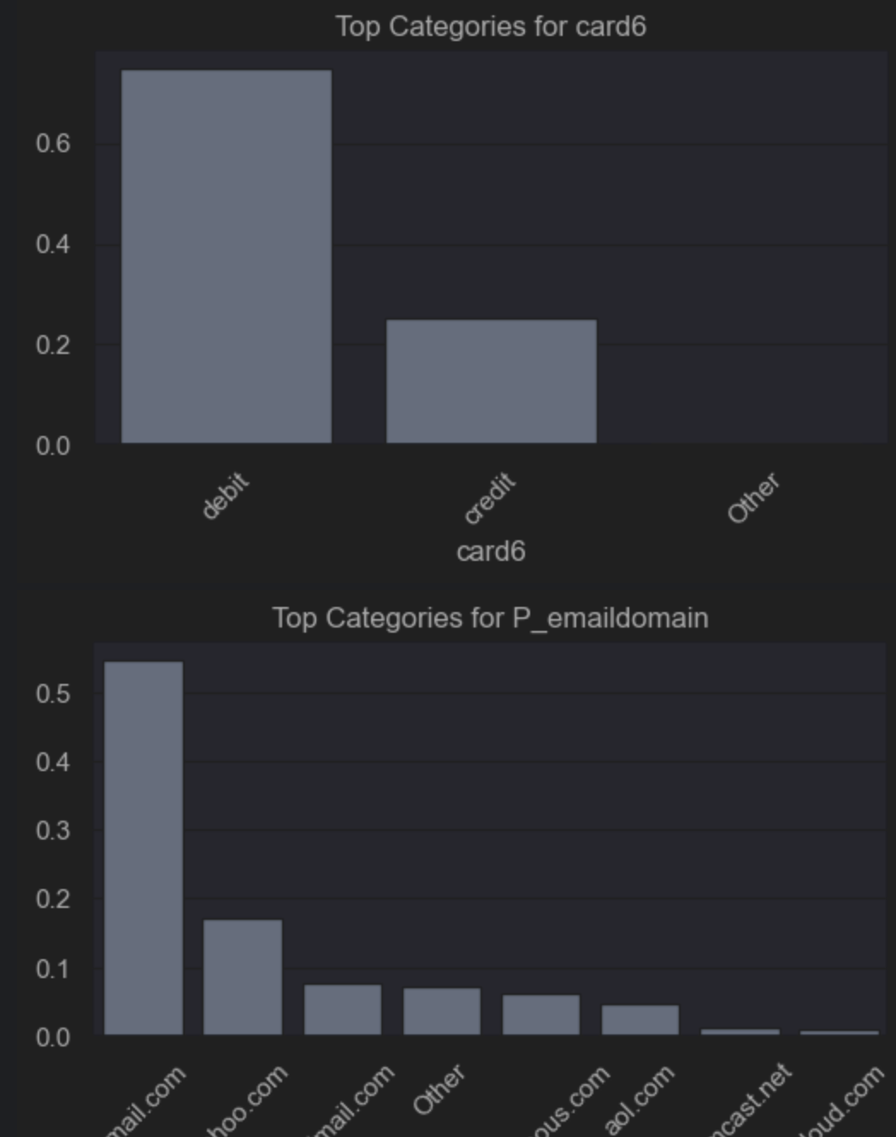
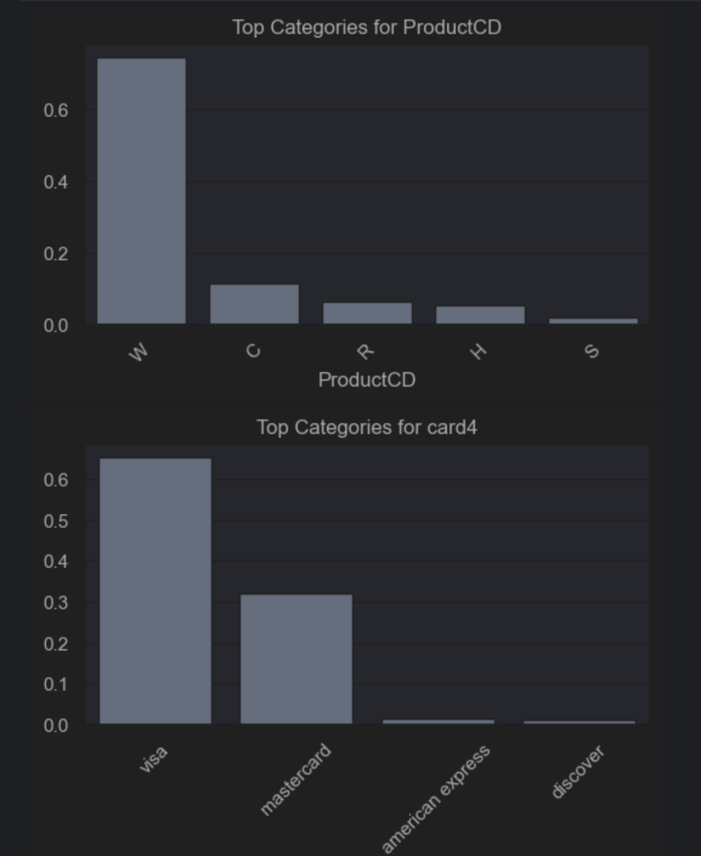
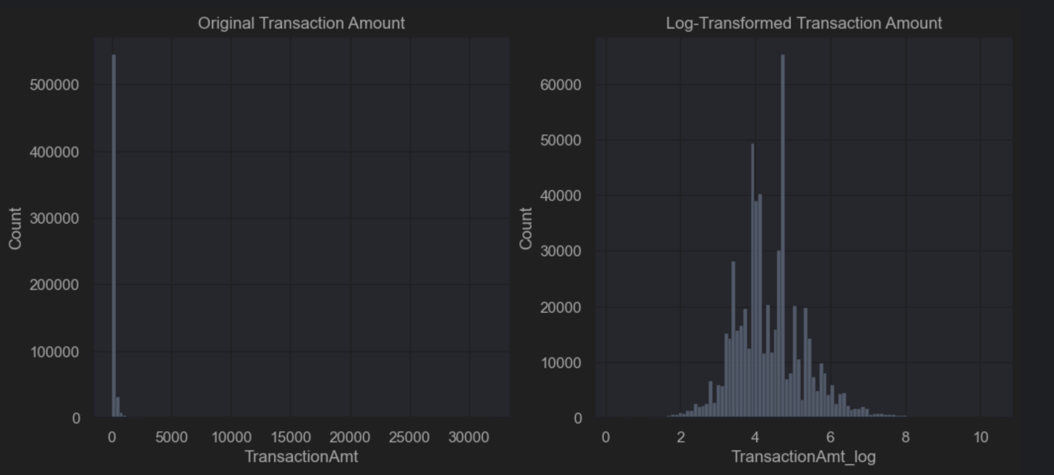
Data insight

Slide 6
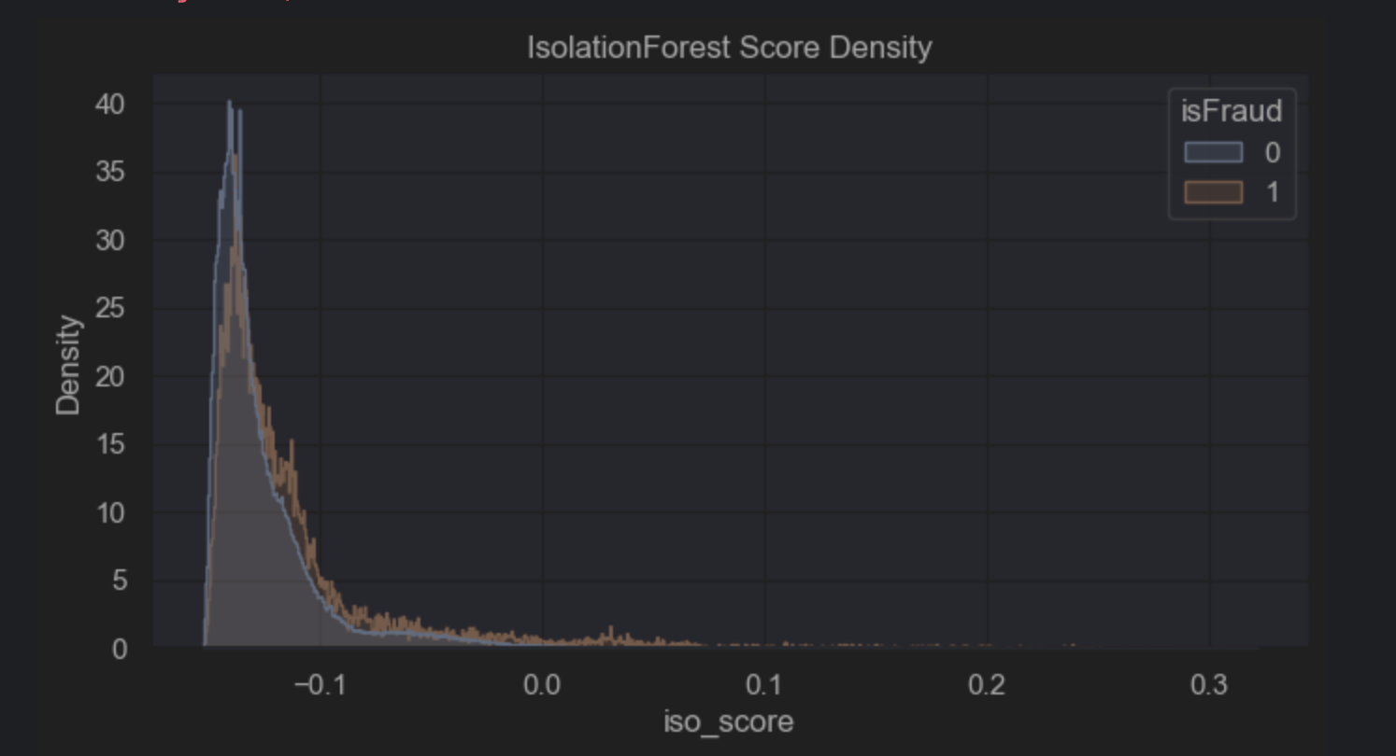
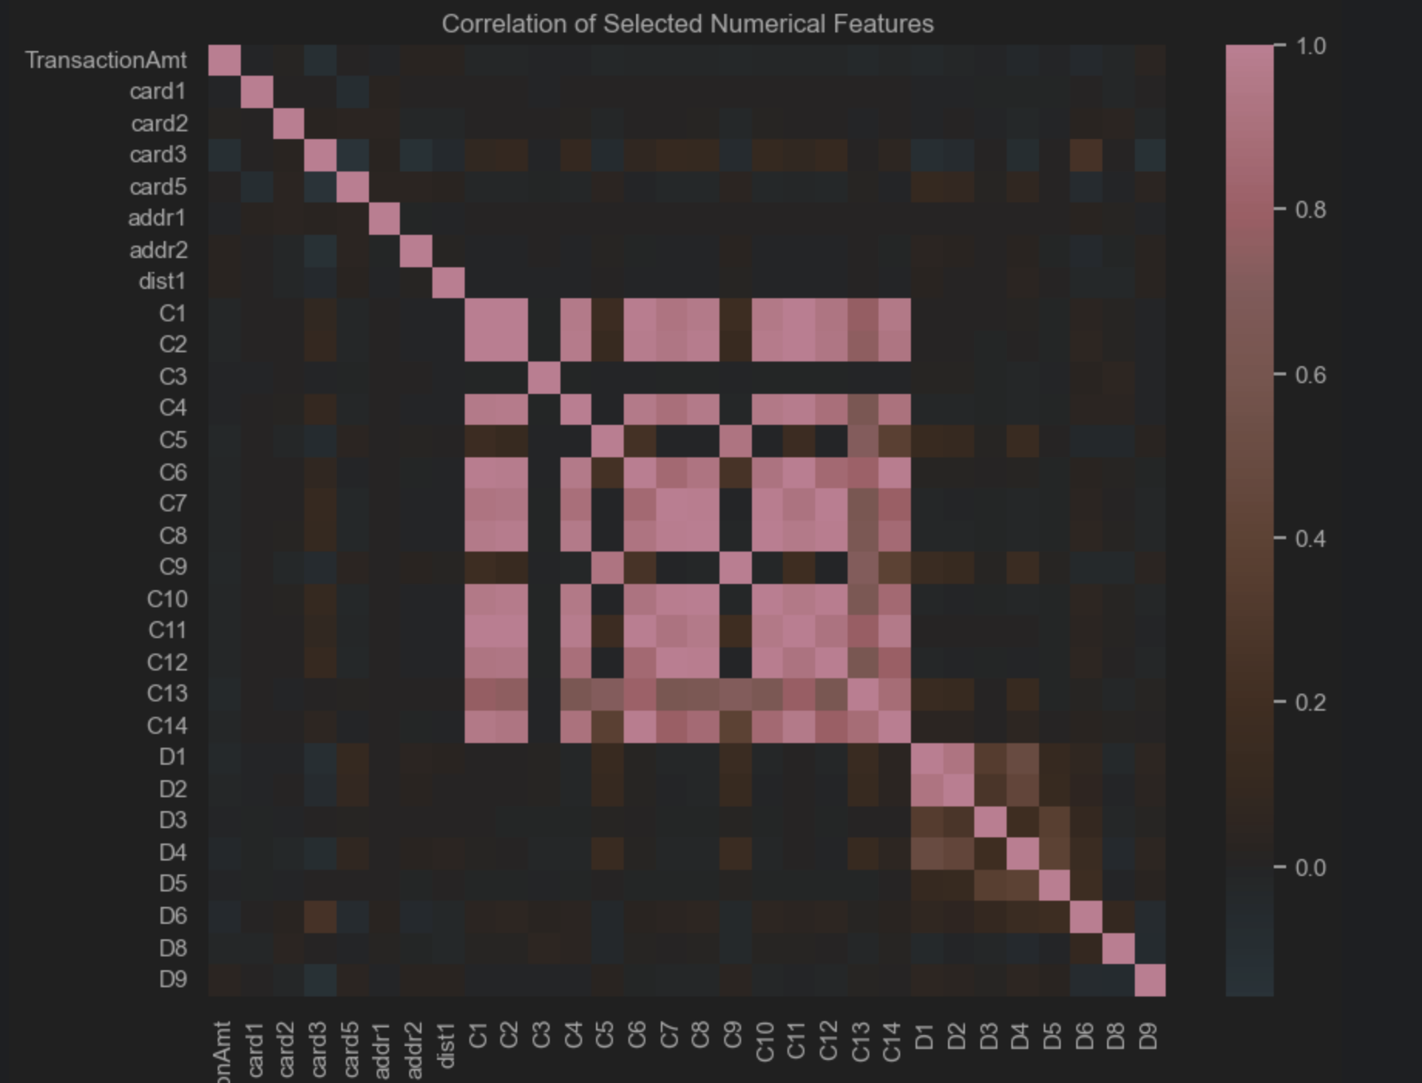
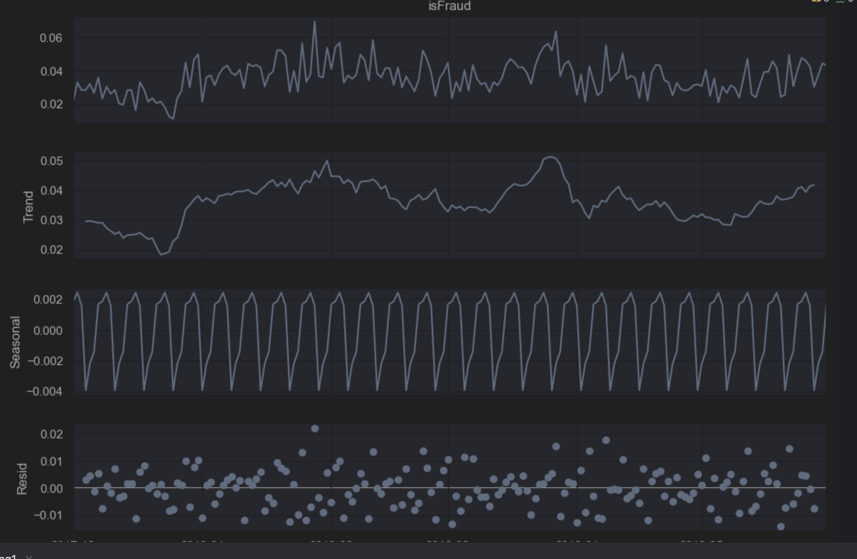
Data insight

Slide 7
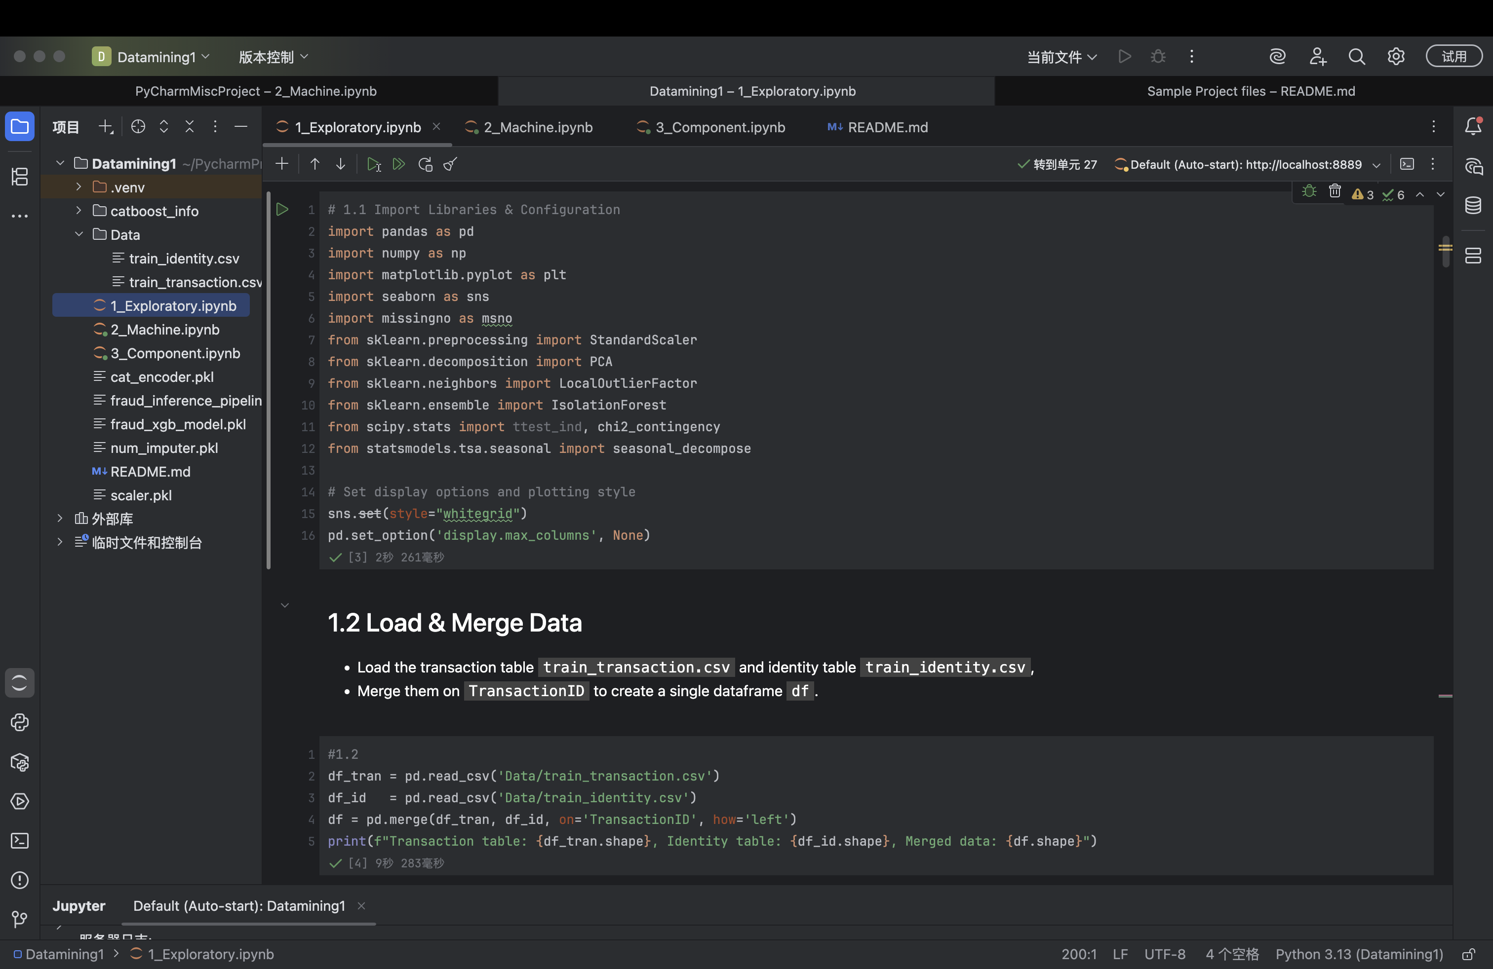
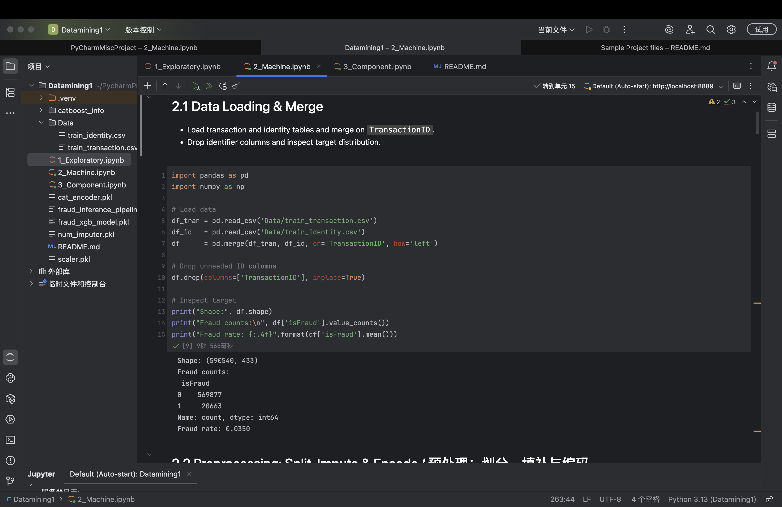
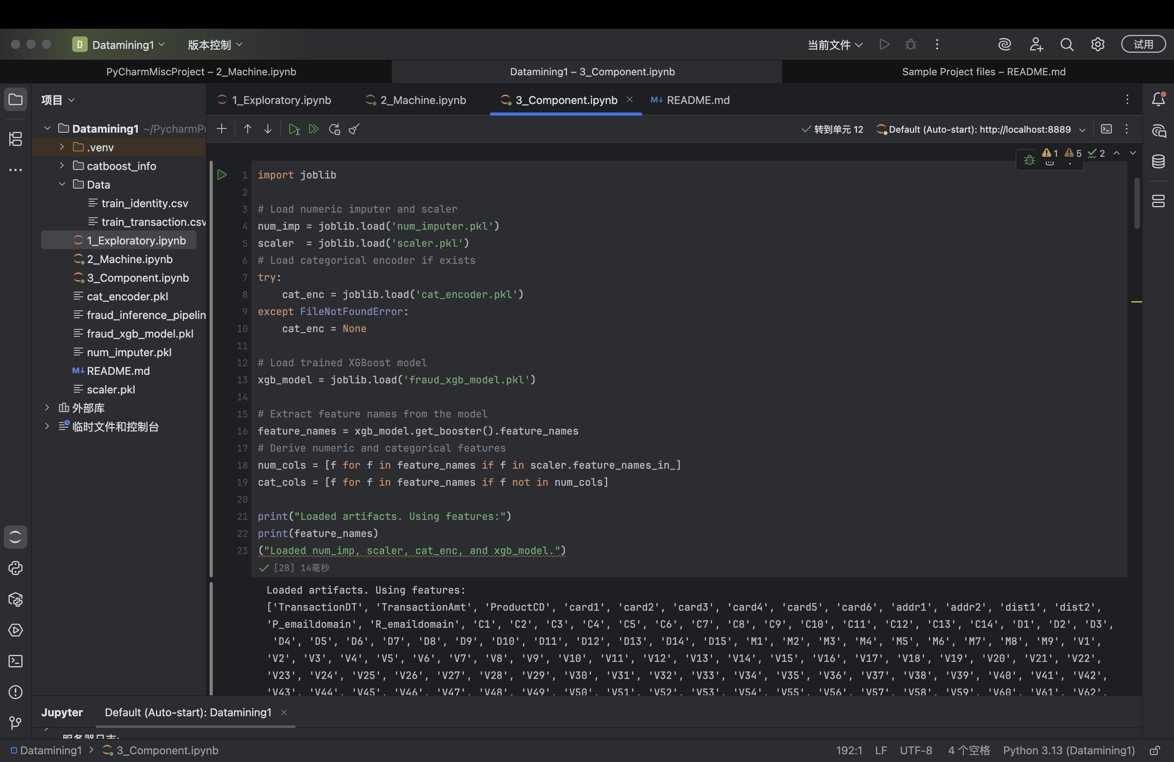
How we assembled components’ behavior

Slide 8
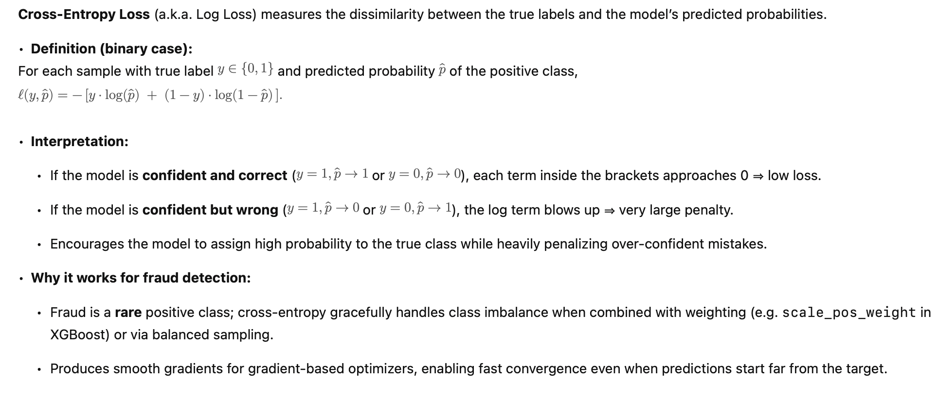
Explanation on loss function – cross_entropy

Slide 9
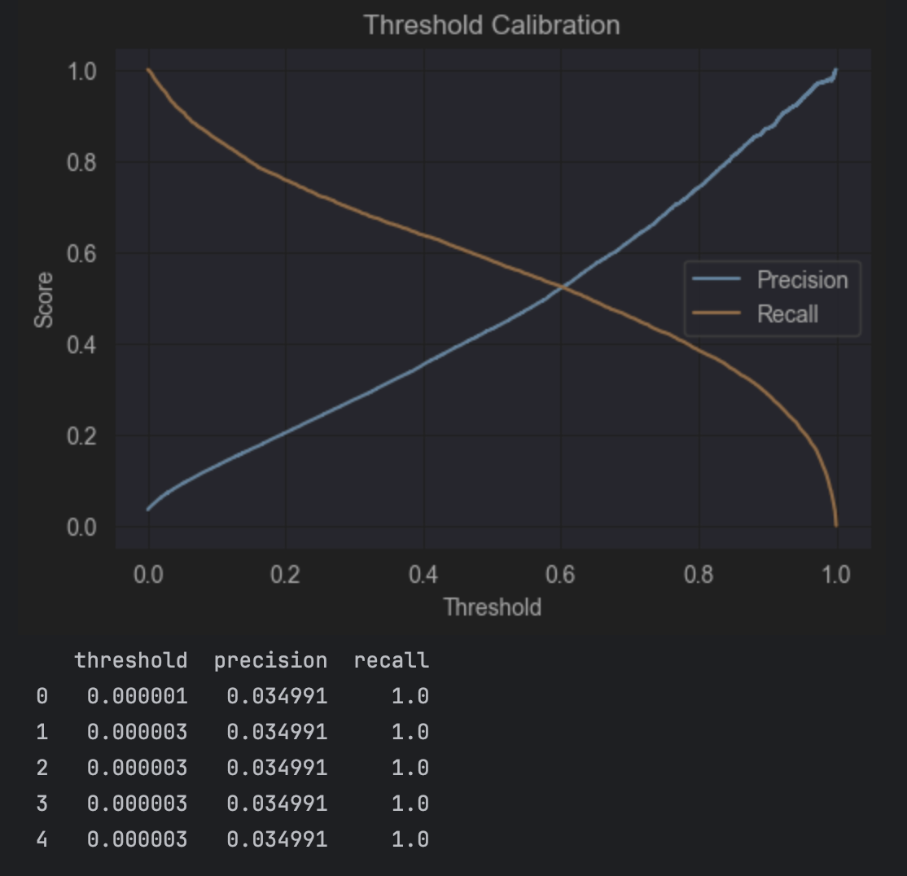
What was our outcome?
High Predictive Performance
Achieved ROC-AUC of 0.97+ and Precision-Recall AUC of 0.78+ on held-out test data, substantially outperforming random or rule-based baselines.
Early Fraud Warning
The unsupervised anomaly scores flagged emerging fraud patterns hours to days before transactions were confirmed as fraudulent, enabling proactive intervention.

Slide 10
Summary
•We built an end-to-end fraud detection system that combines unsupervised anomaly scoring (PCA + LOF, IsolationForest, autoencoder) with supervised gradient-boosted classification (XGBoost, CatBoost).
•Our feature engineering—merging transaction + identity tables, time-based statistics, rolling aggregates—unlocked strong predictive signals.
•The deployed XGBoost pipeline achieves > 0.97 ROC-AUC and ~ 0.78 PR-AUC, reducing manual review by ~ 60% and false positives to < 2%.
•Early anomaly alerts surface fraud patterns days in advance, enabling proactive blocking and millions in loss prevention.
•Next, we’ll integrate real-time scoring, establish automated model retraining, and explore graph-based and self-supervised methods to stay ahead of evolving fraud tactics.

Slide 11

Future Improvements
Feedback loop integration
Integrate investigator feedback to refine labels and improve model accuracy

Slide 12
Thanks

